Slide 1


Visveswaraya Technological University SRI VENKATESHWARA COLLEGE OF ENGINEERING NH7, Vidyanagar, Kempegowda International Airport Road, Bengaluru -562157 DEPARTMENT OF ELECTRONICS & COMMUNICATION ENGINEERING (Accredited By NBA)
INTERNSHIP PRESENTATION ON
“OBSTACLE DETECTION USING RADAR AND WIRELESS DATA RECORDER FOR FLIGHTS ”
Presented by
NAVYASHREE H A(1VE16EC066)
Under the Guidance
Of
Dr. PRAMOD M S
Associate Professor
Dept. of E&CE, SVCE, Bangalore
For the AY : 2019-20

Slide 2
TABLE OF CONTENTS
Certificate
Company profile
About company
Introduction
Objectives
Work carried out
Result
Future scope
Conclusion
References

Slide 3
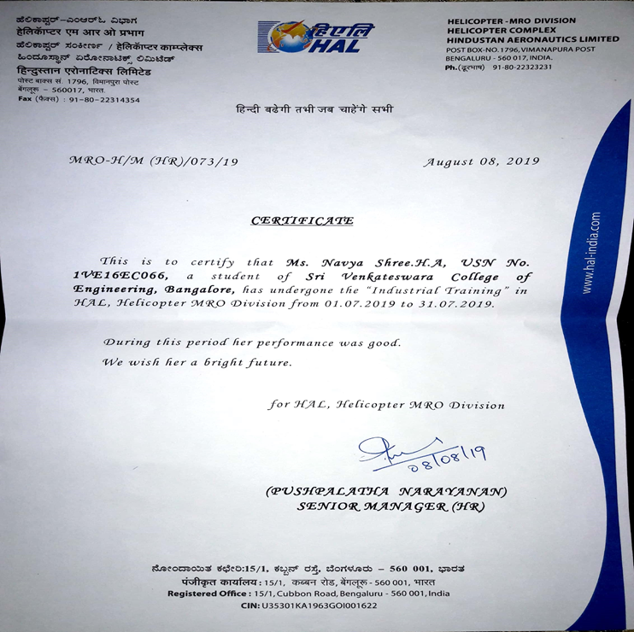
CERTIFICATE

Slide 4

COMPANY PROFILE
HAL was established as Hindustan Aircraft Limited in Bangalore on 23 December 1940 by WALCHAND HIRACHAND who became chairman of the company.
HINDUSTAN AERONAUTICS LIMITED (HAL) is an Indian state owned aerospace and defence company based in Bengaluru, Karnataka. It is governed under the management of the Indian Ministry of Defence.
The government – owned corporation is primarily involved in the operations of the aerospace industry. This include manufacturing , fabrication and assembly of aircraft, jet engines, helicopters and their spare parts.

Slide 5
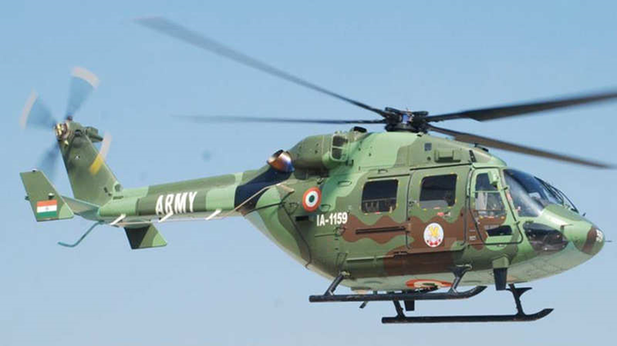
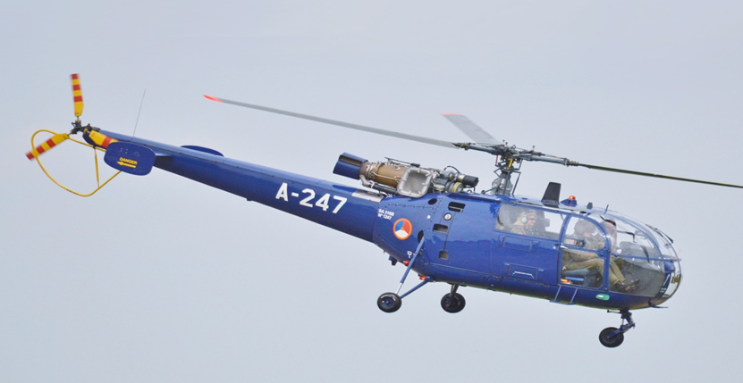
ABOUT COMPANY
HAL is currently meeting the requirements of structures for aerospace launch vehicles and satellites of ISRO through its dedicated Aerospace Division.
HAL has also contributed to Mars mission by supplying riveted structural assemblies and welded propellant tankages for the Polar Satellite Launch Vehicle (PSLV-C25).
Today, HAL has 19 Production Units and 9 Research and Design Centers in 7 locations in India.
HAL has been successful in numerous R & D programs developed for both Defence and Civil Aviation sectors.
Figure 1: ALH (Dhruv)
Figure 2: HAL Cheetah

Slide 6
INTRODUCTION
Today there are hundreds of plane flying around the world. Some of the Airports have hundreds of plane landing in a very short span of time. Any mistakes at this point of time can mean accident.
Sometimes weather can be foggy or it can rain heavily making the runway slippery which can lead to Pilot’s nervousness and it is possible he can neglect any sign of any parameter being faulty.
Here we are logging the Plane’s Parameter online, parameters like Engine Temperature, Fuel Level, Speed, Location (Latitude and Longitude) etc., for this we have used respective sensors interfaced to the Micro-Controller through Multiplexer and ADC and a On Board GPS to sense the exact location of the plane.
The plane sends this information online via ZIGBEE to the Ground unit which keeps a track of hundreds of planes at one time.

Slide 7
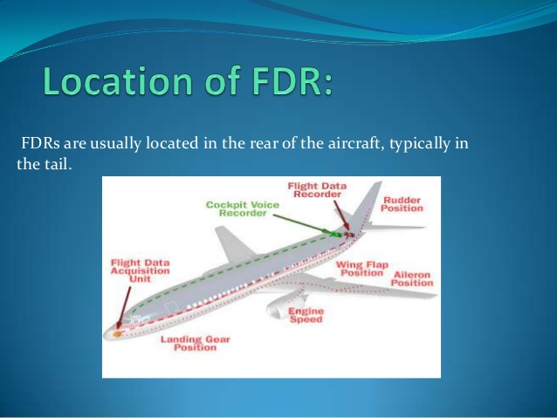
FLIGHT RECORDER:
A flight recorder is an electronic recording device placed in an aircraft for the purpose of facilitating the investigation of aviation accidents and incidents.
There are two different flight recorder devices: the flight data recorder (FDR) preserves the recent history of the flight through the recording of dozens of parameters collected several times per second.
The cockpit voice recorder (CVR) preserves the recent history of the sounds in the cockpit, including the conversation of the pilots.
Figure 3: Typical location of Flight Data Recorder

Slide 8
RADAR:
Radar is an object detection system which uses radio waves to determine the range, altitude, direction, or speed of objects.
Some radar systems are used for air-traffic control at airports and others are used for long range surveillance and early warning systems.
A radar system is the heart of a missile guidance system.
Small portable radar systems that can be maintained and operated by one person are available as well as systems that occupy several large rooms.
High tech radar systems are associated with digital signal processing and are capable of extracting useful information from very high noise levels.

Slide 9
OBJECTIVES
To achieve a high level of reliability and availability in production system.
To record specific aircraft performance parameters.
To alert the pilot about the fuel level and gas leakage level.
To measure the temperature within the cabin.
To measure temperature, altitude and pressure using radar.
To detect the presence of any object within the specified range using radar.

Slide 10
WORK CARRIED OUT
The design of simple Radar application using Arduino UNO is done. Radar is a long range object detection system that uses radio waves to establish certain parameters of an object like its range, speed and position.
Radar technology is used in aircrafts, missiles, marine, weather predictions and automobiles.
Further, it deals with logging the Plane’s Parameter online, parameters like Engine Temperature, Fuel Level, Speed, Location (Latitude and Longitude) etc.
For this we have used respective sensors interfaced to the Micro-Controller through Multiplexer and ADC and a On Board GPS to sense the exact location of the plane.

Slide 11
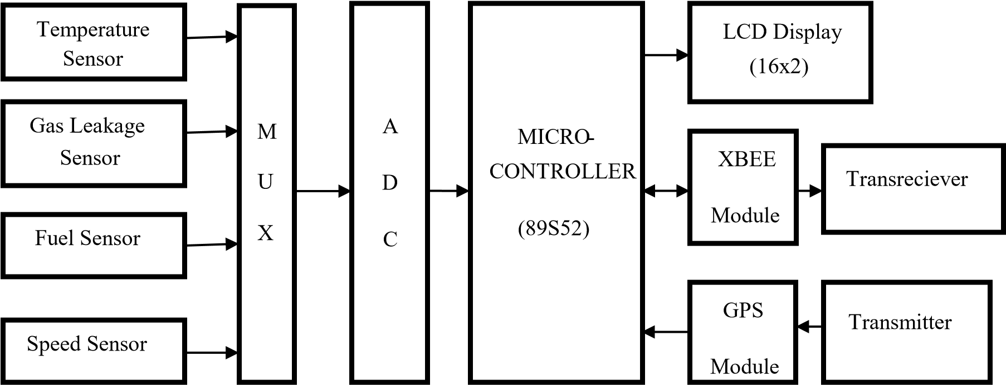
BLOCK DIAGRAM
Figure 4: Block diagram of Wireless flight data recorder

Slide 12
METHODOLOGY
In the Figure 4., four different sensors such as fuel sensor, gas leakage sensor, temperature sensor, speed sensor are used and GPS will give the details of position of plane.
The micro-controller will store the data, and display the changes in sensors on the LCD. We are using LCD in order to show the correctness with the ground unit.
A pair of XBEE OEM PRO which acts as trans-receiver. The data stored in the micro-controller will be send via XBEE on plane to the ground XBEE.
The data can be seen on the VB designed window, which will display all the parameters of plane on our PC which will be in real time.

Slide 13
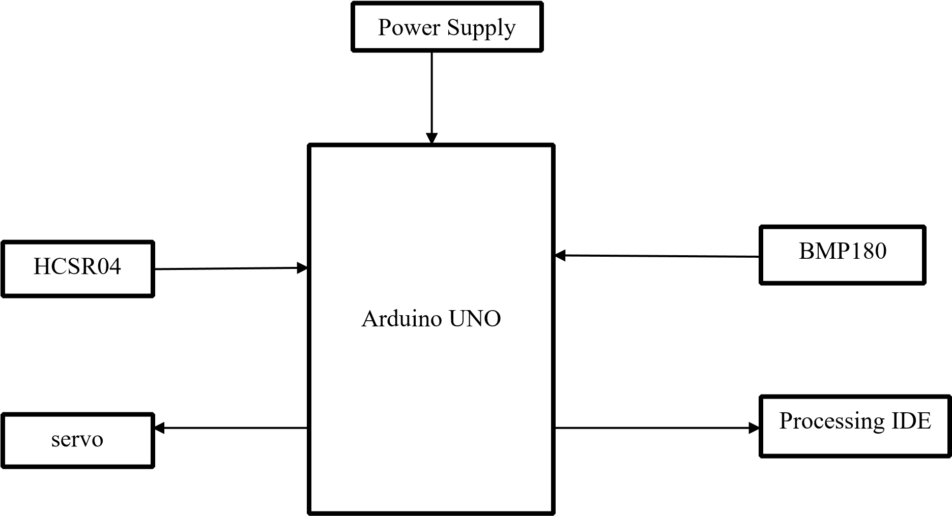
Obstacle Detection Using Radar
Figure 5: Block Diagram of Obstacle Detection using radar

Slide 14
Continued…
The block diagram shown in Figure 5.,illustrates the measure of distance position and speed of the obstacle set at some distance from the sensor.
Ultrasonic sensor sends the ultrasonic wave in various ways by rotating with help of servo motors. This wave goes in air and gets reflected back subsequent to striking some object.
This wave is again detected by the sensor and its qualities is analyzed and output is shown in screen indicating parameters, for example, distance and position of object.

Slide 15
Continued…
Arduino IDE is utilized to compose code and transfer coding in Arduino and causes us to detect position or angle of servo motor and it is communicated through the serial port alongside the covered distance of the nearest object in its way.
Implementations of the sensors are done in such a way that ultra-sonic sensor is attached on top of the servo motor because it has to detect the object and its distance.
Based on the rotation of ultrasonic sensor, the graphical representation of the data is shown in red colour. During the period of rotation, if the presence of any object is detected, the graphical representation in green turns red colour.

Slide 16
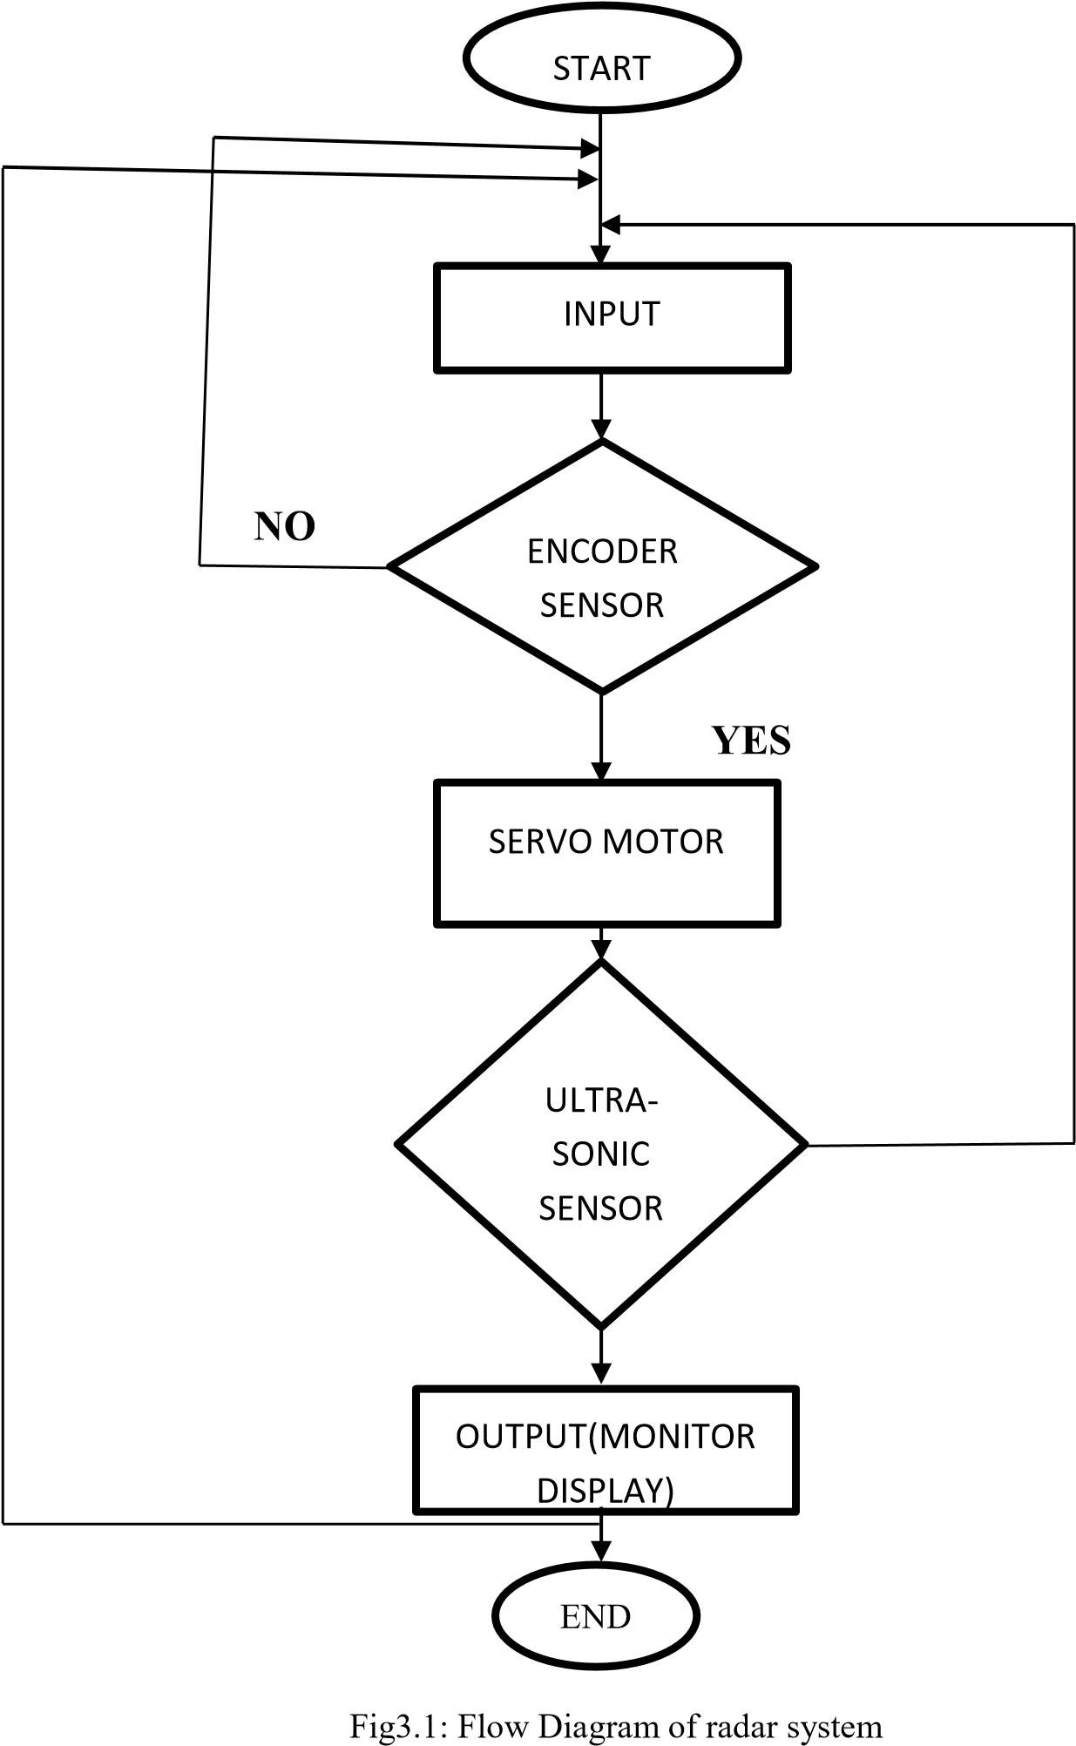
FLOW CHART
Figure 6: Flow chart of radar system

Slide 17
Continued…
The flow chart shown in the Figure 6., explains the working and the decision flow of radar system.
As it can be seen the system starts with an input i.e. when the ultrasonic sensor detects an object, or does not detects any object, at any condition the encoder feeds the information in the controller while the servo keeps constantly rotating.
As soon as any obstacle/object is detected by the ultrasonic sensor the data is immediately processed by the controller.
Here the process ends with an estimated distance of the object from the system with the angle at which it is placed.

Slide 18
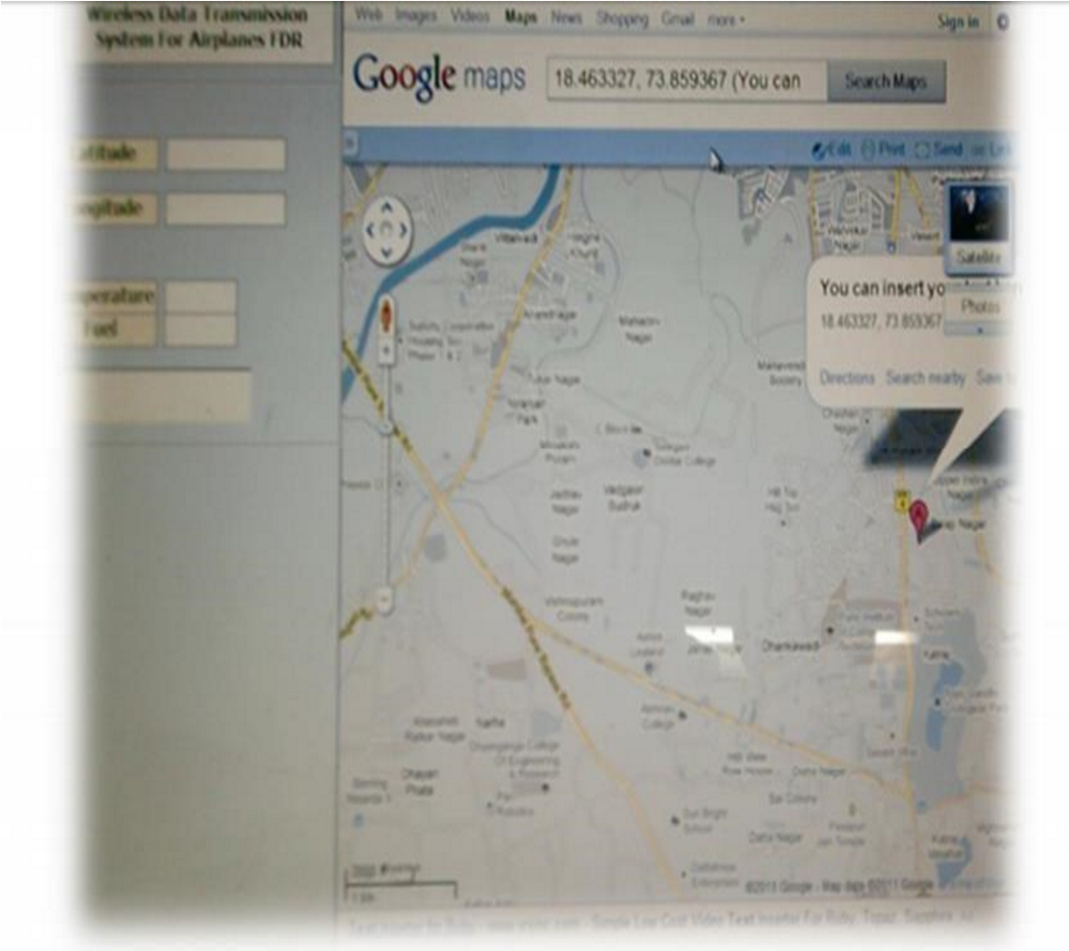
OUTPUT
The Figure 7., shows the visual basic window of wireless flight data recorder.
Figure 7: Visual basic window of Flight data recorder

Slide 19
Continued…
Future of Wireless flight data recorder are:
Data Recording : A Wireless FDR can record parameters such as Fuel Level, Engine Temperature, Cabin Temperature, Location (latitude and longitude via GPS) of Airplane and display same data of plane in personal computer so that if the FDR gets lost or if because of some problem it stops working, the data will be stored in PC.
Pilot can be informed : At any EMERGENCY, if due to some reason pilot didn’t notices the malfunction in plane, pilot can be alerted, immediately. Such that hundreds of lives can be saved and also many Air Disasters can be prevented.
Prevent Future Accident : It is possible to find the reason of an accident, which could be rectified in future.

Slide 20
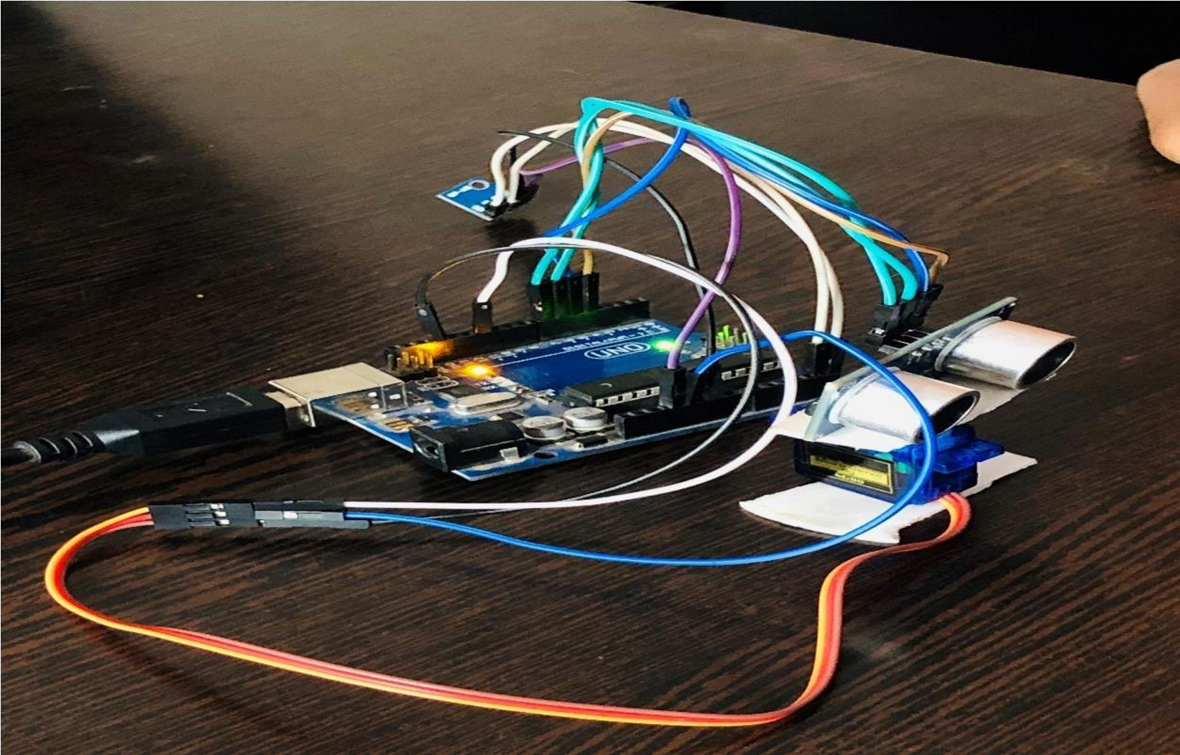
Continued…
The Figure 8., shows the interfacing of Arduino UNO with the servo motor, BMP180 sensor and ultrasonic sensor.
Figure 8: Circuit Of obstacle detection via Radar

Slide 21
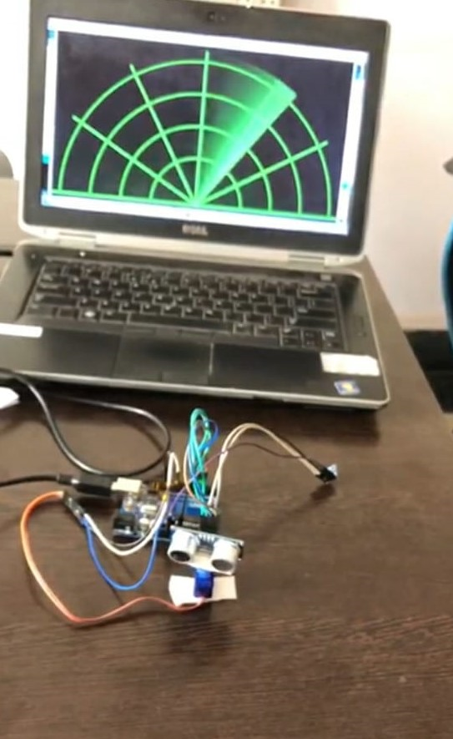
The Figure 9., shows the graphical representaton before the obstacle detection. Hence the graph is represented in green colour indicating that there is no obstacle nearby it.
Figure 9: Graphical representation (Before the detection of an obstacle)

Slide 22
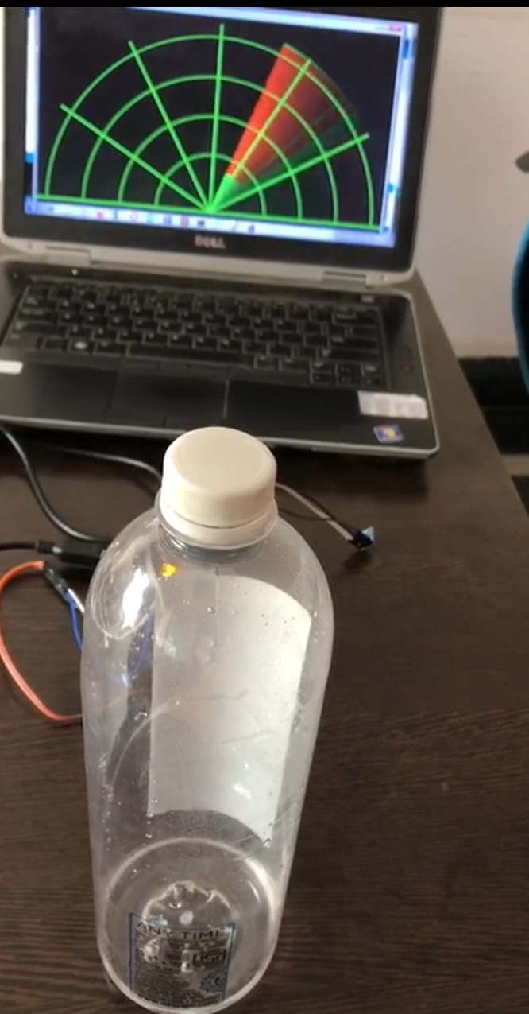
The Figure 10., shows the graphical representaton after the obstacle detection. Hence the graph is represented in red colour indicating that there is an obstacle nearby it.
Figure 10: Graphical Representation (after the detection of the obstacle)

Slide 23
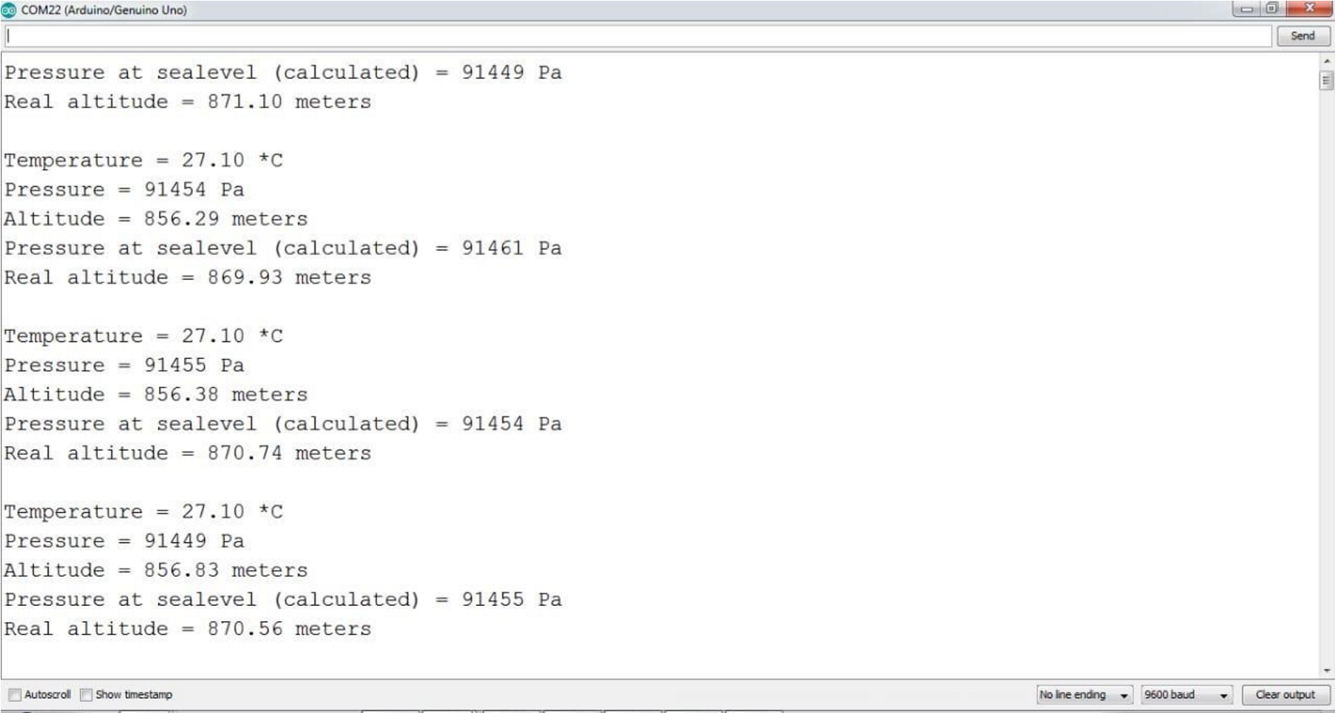
COMMAND WINDOW
In the command window, the calculated temperature, pressure, altitude and pressure at sea-level, based on the resolution is displayed.
Figure 11: Output of BMP180

Slide 24
FUTURE SCOPE
More aircraft’s types will be required to carry FDR and more stringent environment tests will be added.
Mandatory storage of images of the cockpit and instruments will be required. The privacy and integrity of FDR data for civilian aircraft will also be gathered.
Collecting structural health data with wireless technologies in the future, perhaps the need of Block Box may be eliminated.

Slide 25
CONCLUSION
In internship, it helped us to understand the working principle of wireless flight data recorder and measurement of temperature, pressure using radar and evaluated the performance of flight.
Also got an opportunity to interact with the team members and found that the parameters from sensor’s output of aircraft are acquired and desired parameter is stored in the data recorder.
We can have an idea of an efficiency of the radar by testing objects at different levels and observe how faster or smoothly it detects an object that it finds in a way and gives us an expected range of the obstacle.

Slide 26
REFERENCES
Shreyas Mehta, Shashank Tiwari “Radar System Using Arduino and Ultrasonic Sensor” IJNRD, Volume 3, Issue 4 April 2018.
Srijan Dubey, Supragya Tiwari, Simit Roy “Implementation Of Radar Using Ultrasonic Sensor” Indian J.Sci.Res.2018.
Antonio Tedeschi, Stefano Calcaterra, Francesco Benedetto “Ultrasonic Radar System: Arduino and Virtual Reality for a Light-Free Mapping of Indoor Environments” IEEE Sensors Journal Volume: 17, Issue: 14, July 15, 2017.
Krishna M. Kavi, ”Beyond The Black box”, IEEE Spectrum, August 2016,pp.44-48.
Jerry Nelson, “Thinking out of the box”, IEEE Spectrum, September 2016, pp.08.

Slide 27
THANK YOU

